Slide 1

International Baccalaureate

Slide 2


Slide 3
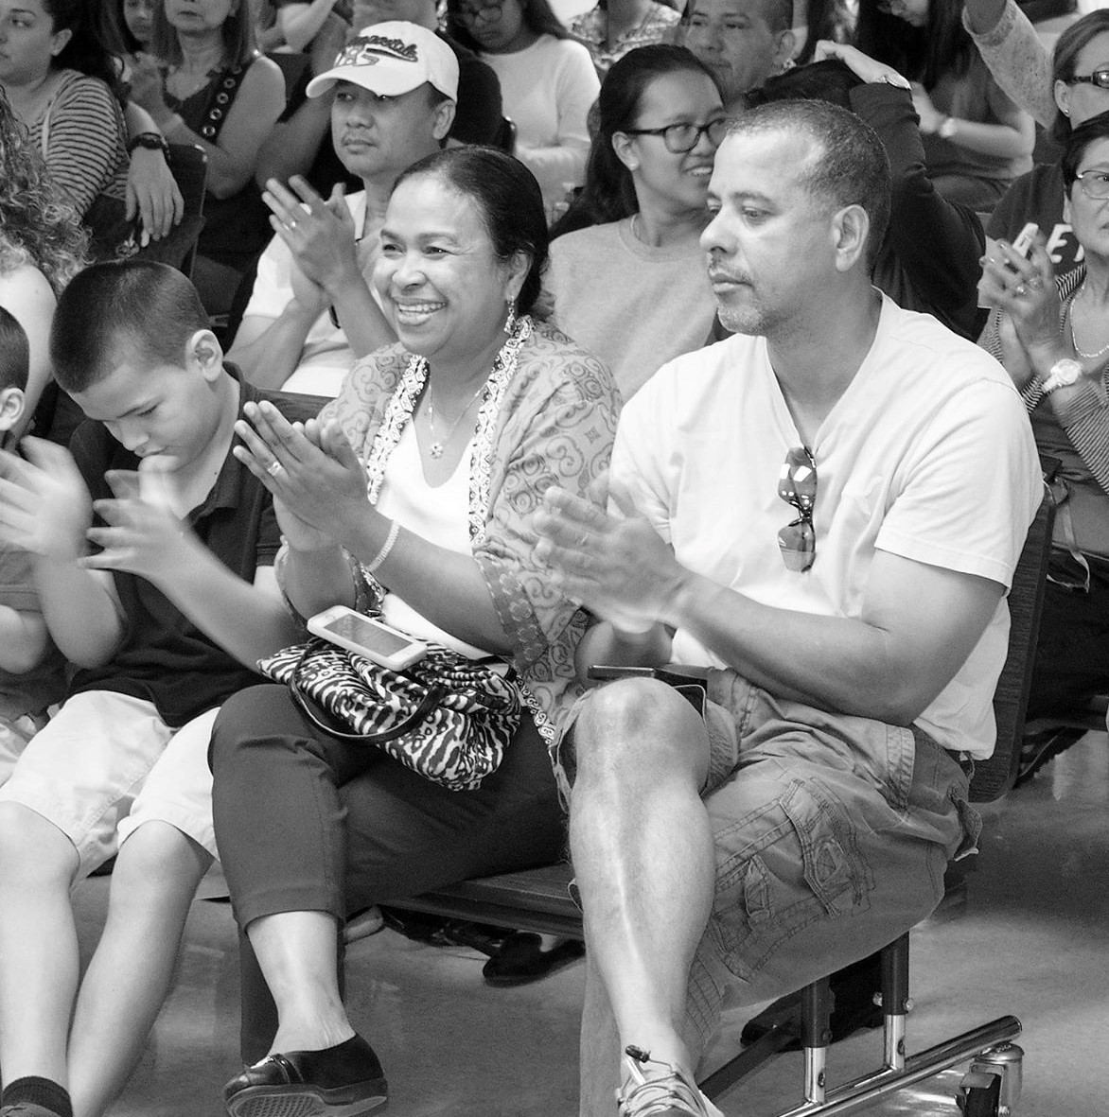
I am thankful

Slide 4
Appreciation

Slide 5
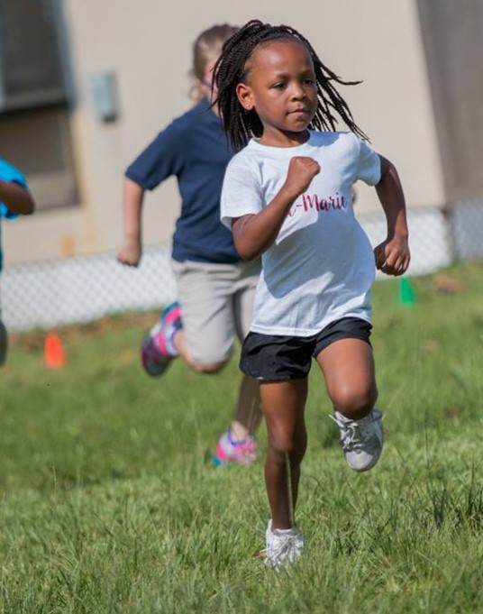
I will not give up!

Slide 6
Commitment

Slide 7
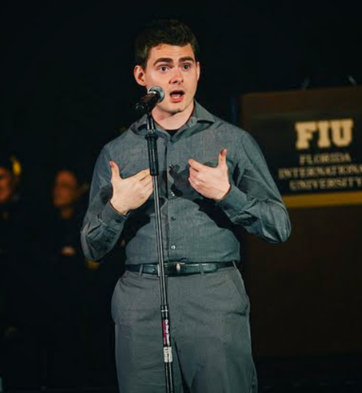
I know I can!

Slide 8
Confidence

Slide 9
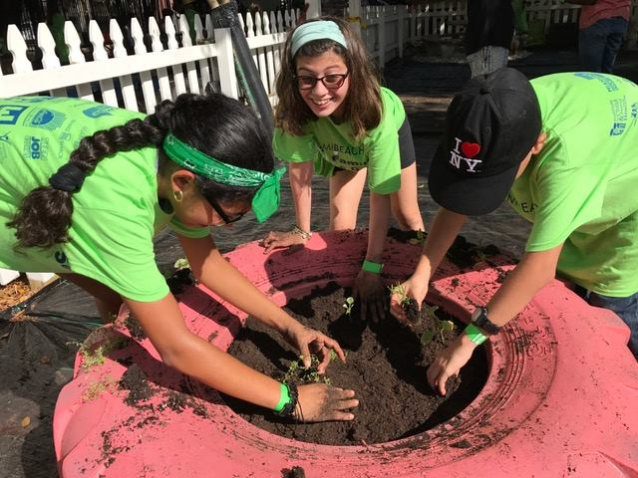
I work with
others!

Slide 10
Cooperation

Slide 11
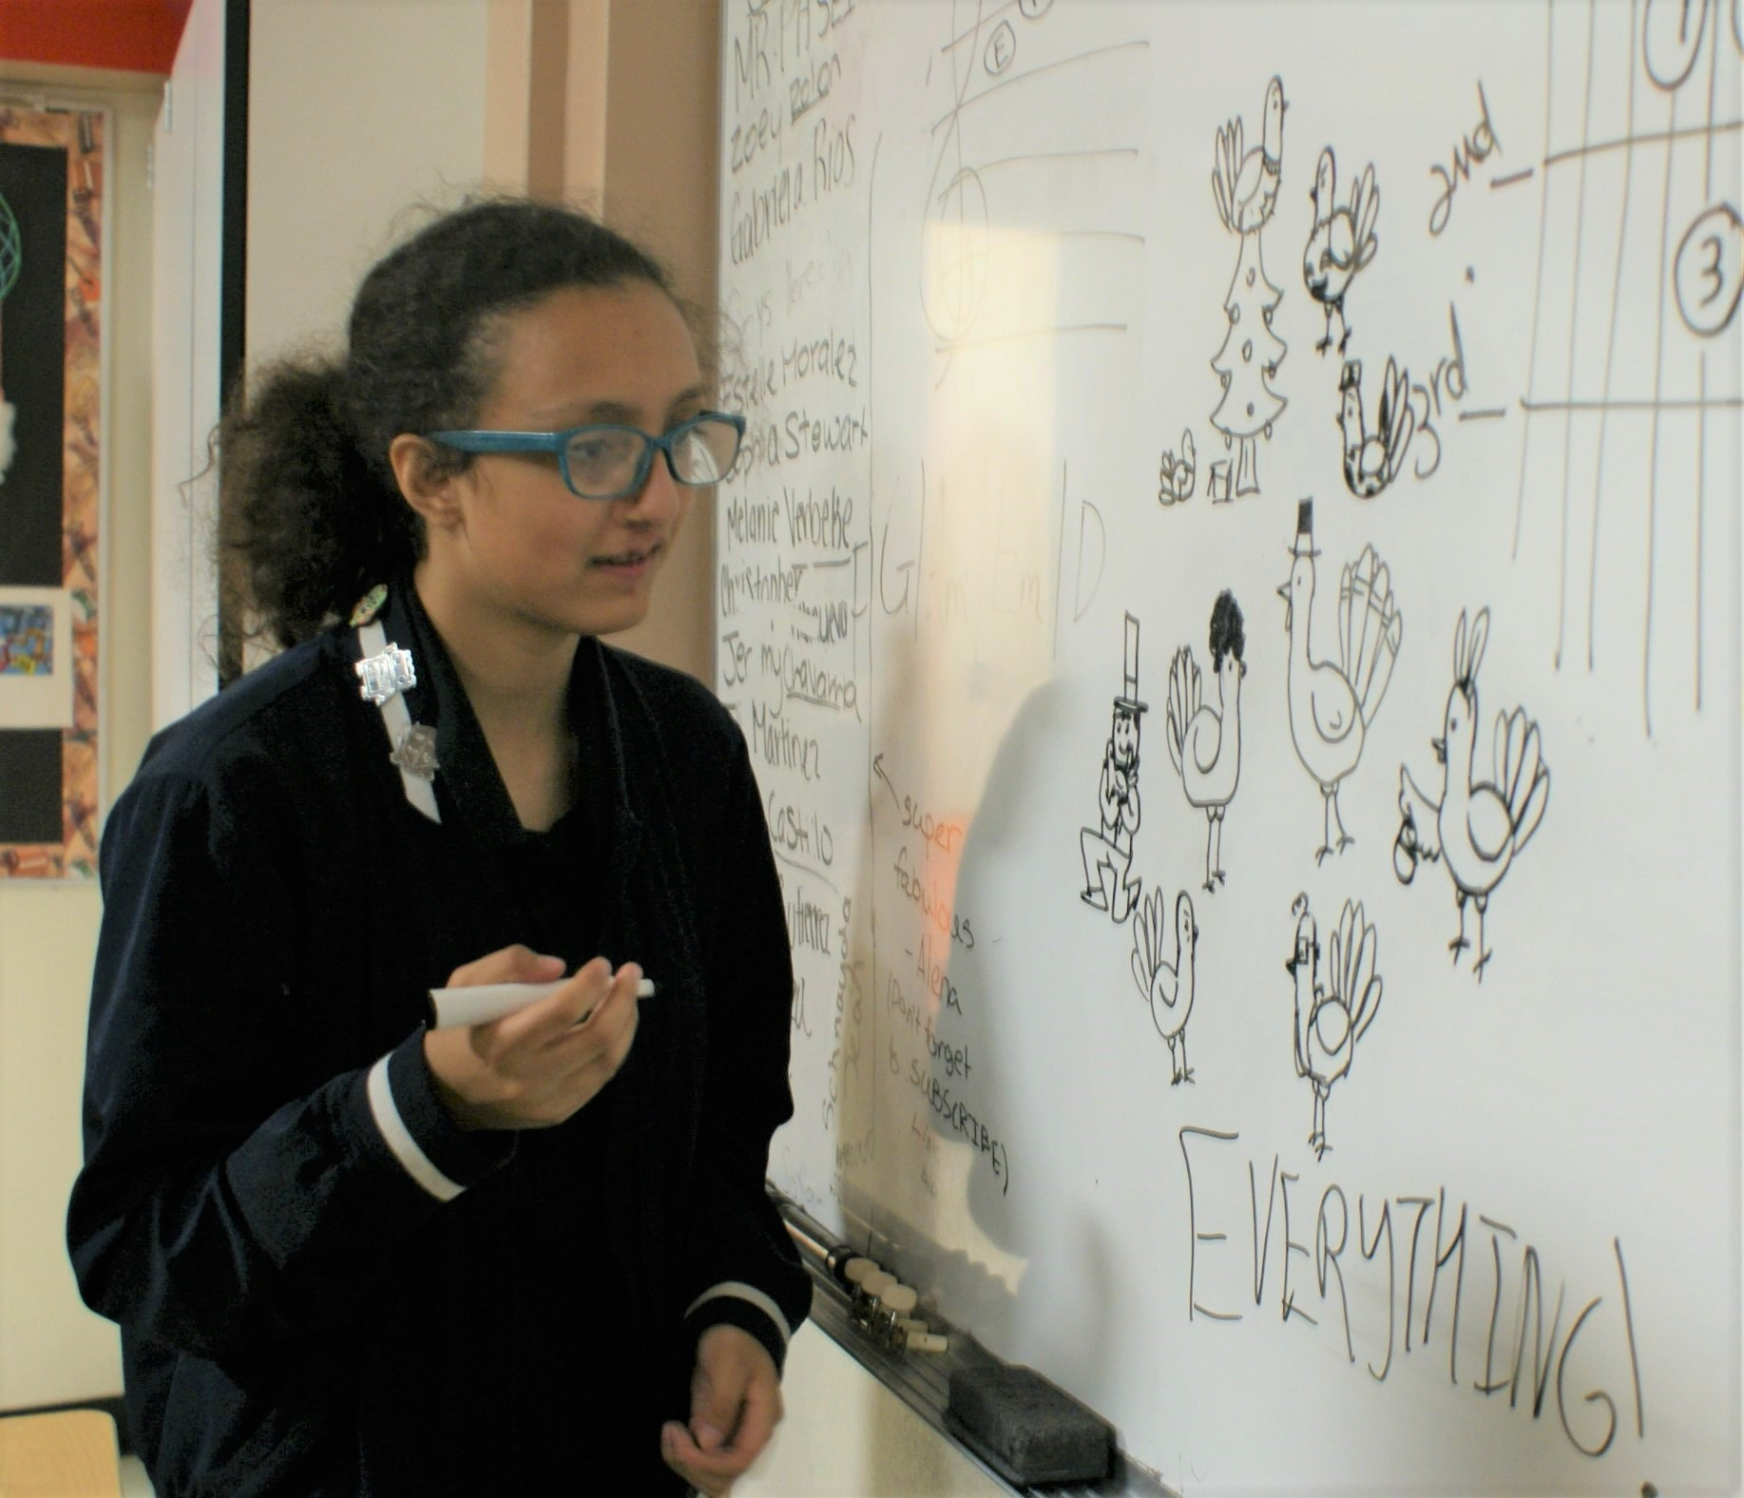
I have an idea!

Slide 12
Creativity

Slide 13
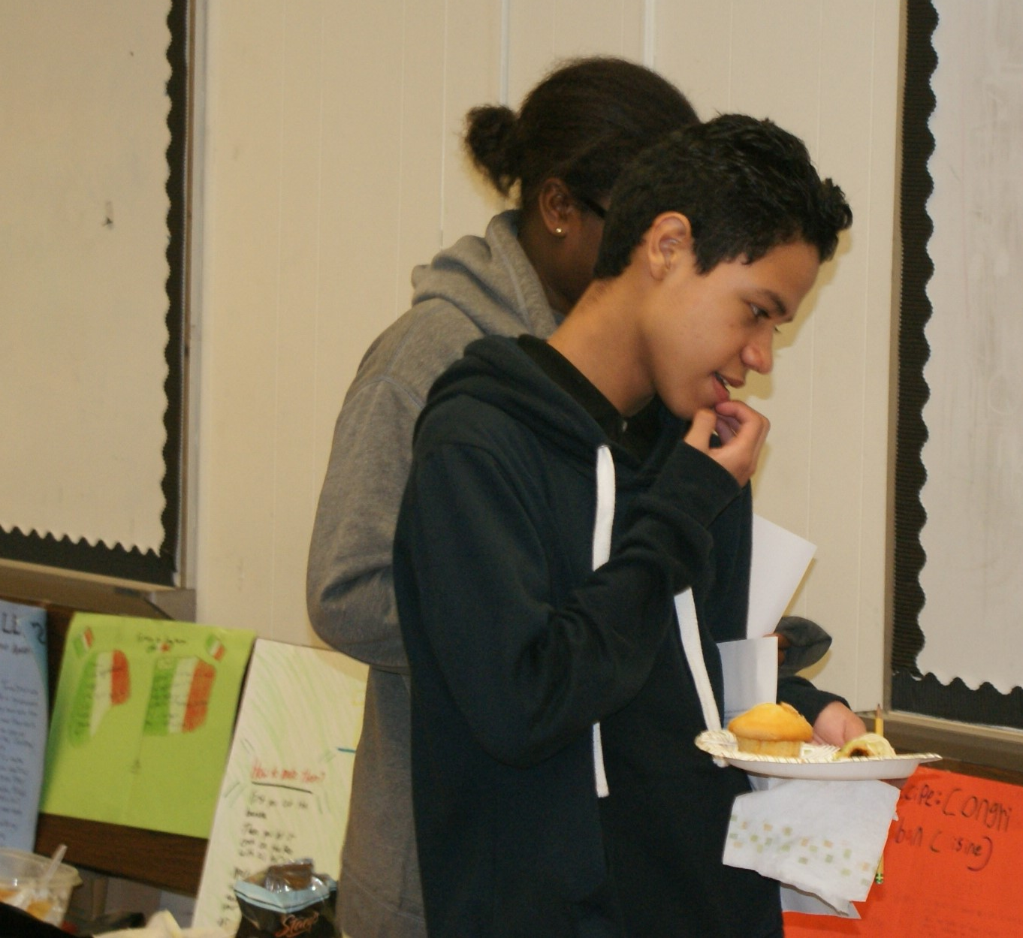
I wonder…

Slide 14
Curiousity

Slide 15
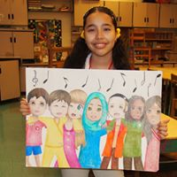
I know how
you feel

Slide 16
Empathy

Slide 17
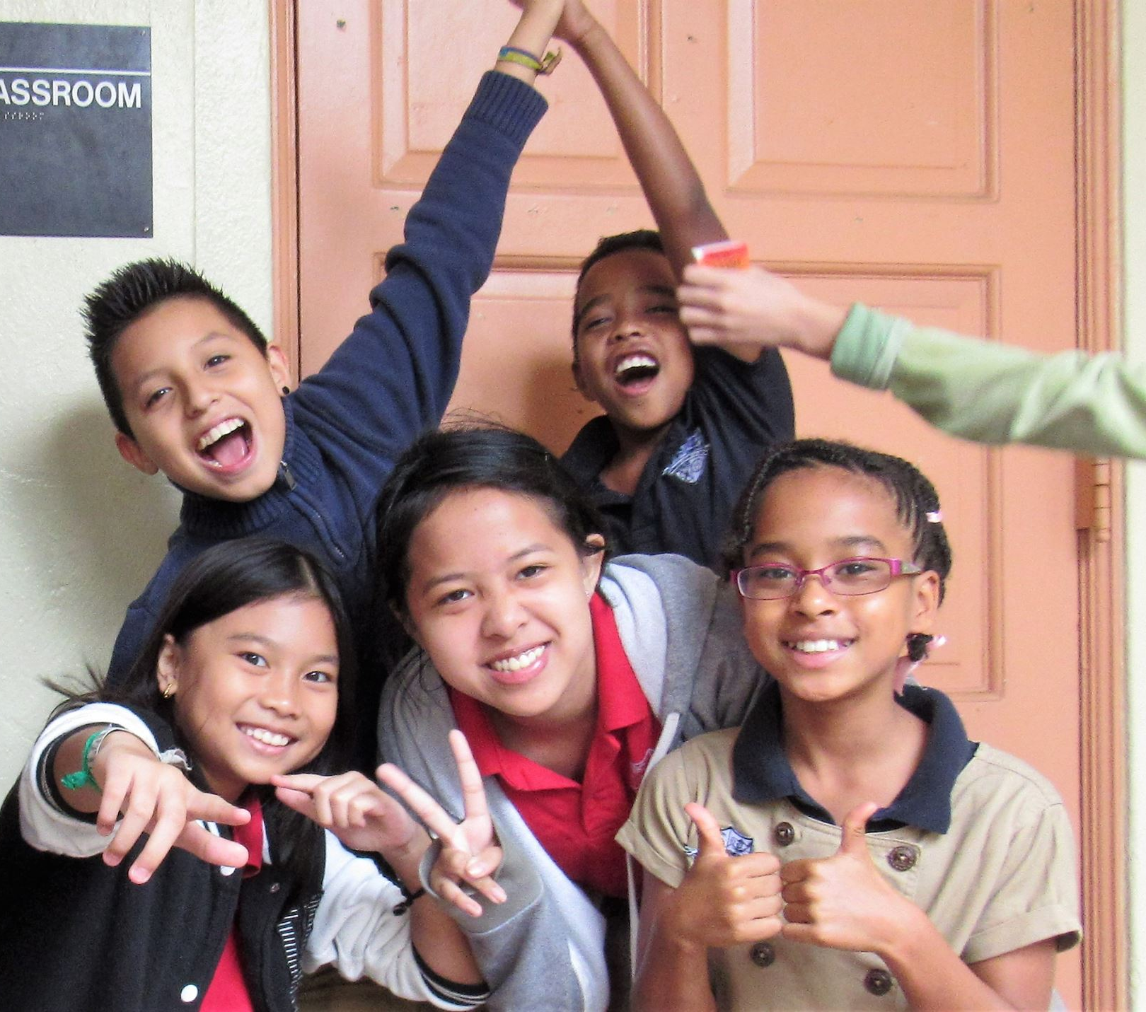
I am excited!

Slide 18
Enthusiasm

Slide 19
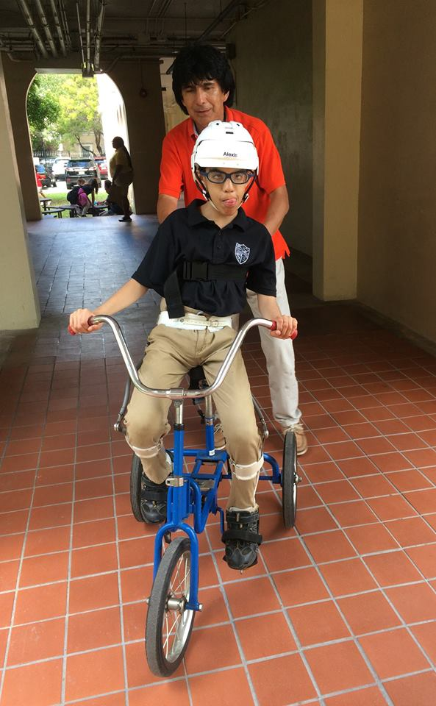
I can do it
by myself

Slide 20
Independence

Slide 21
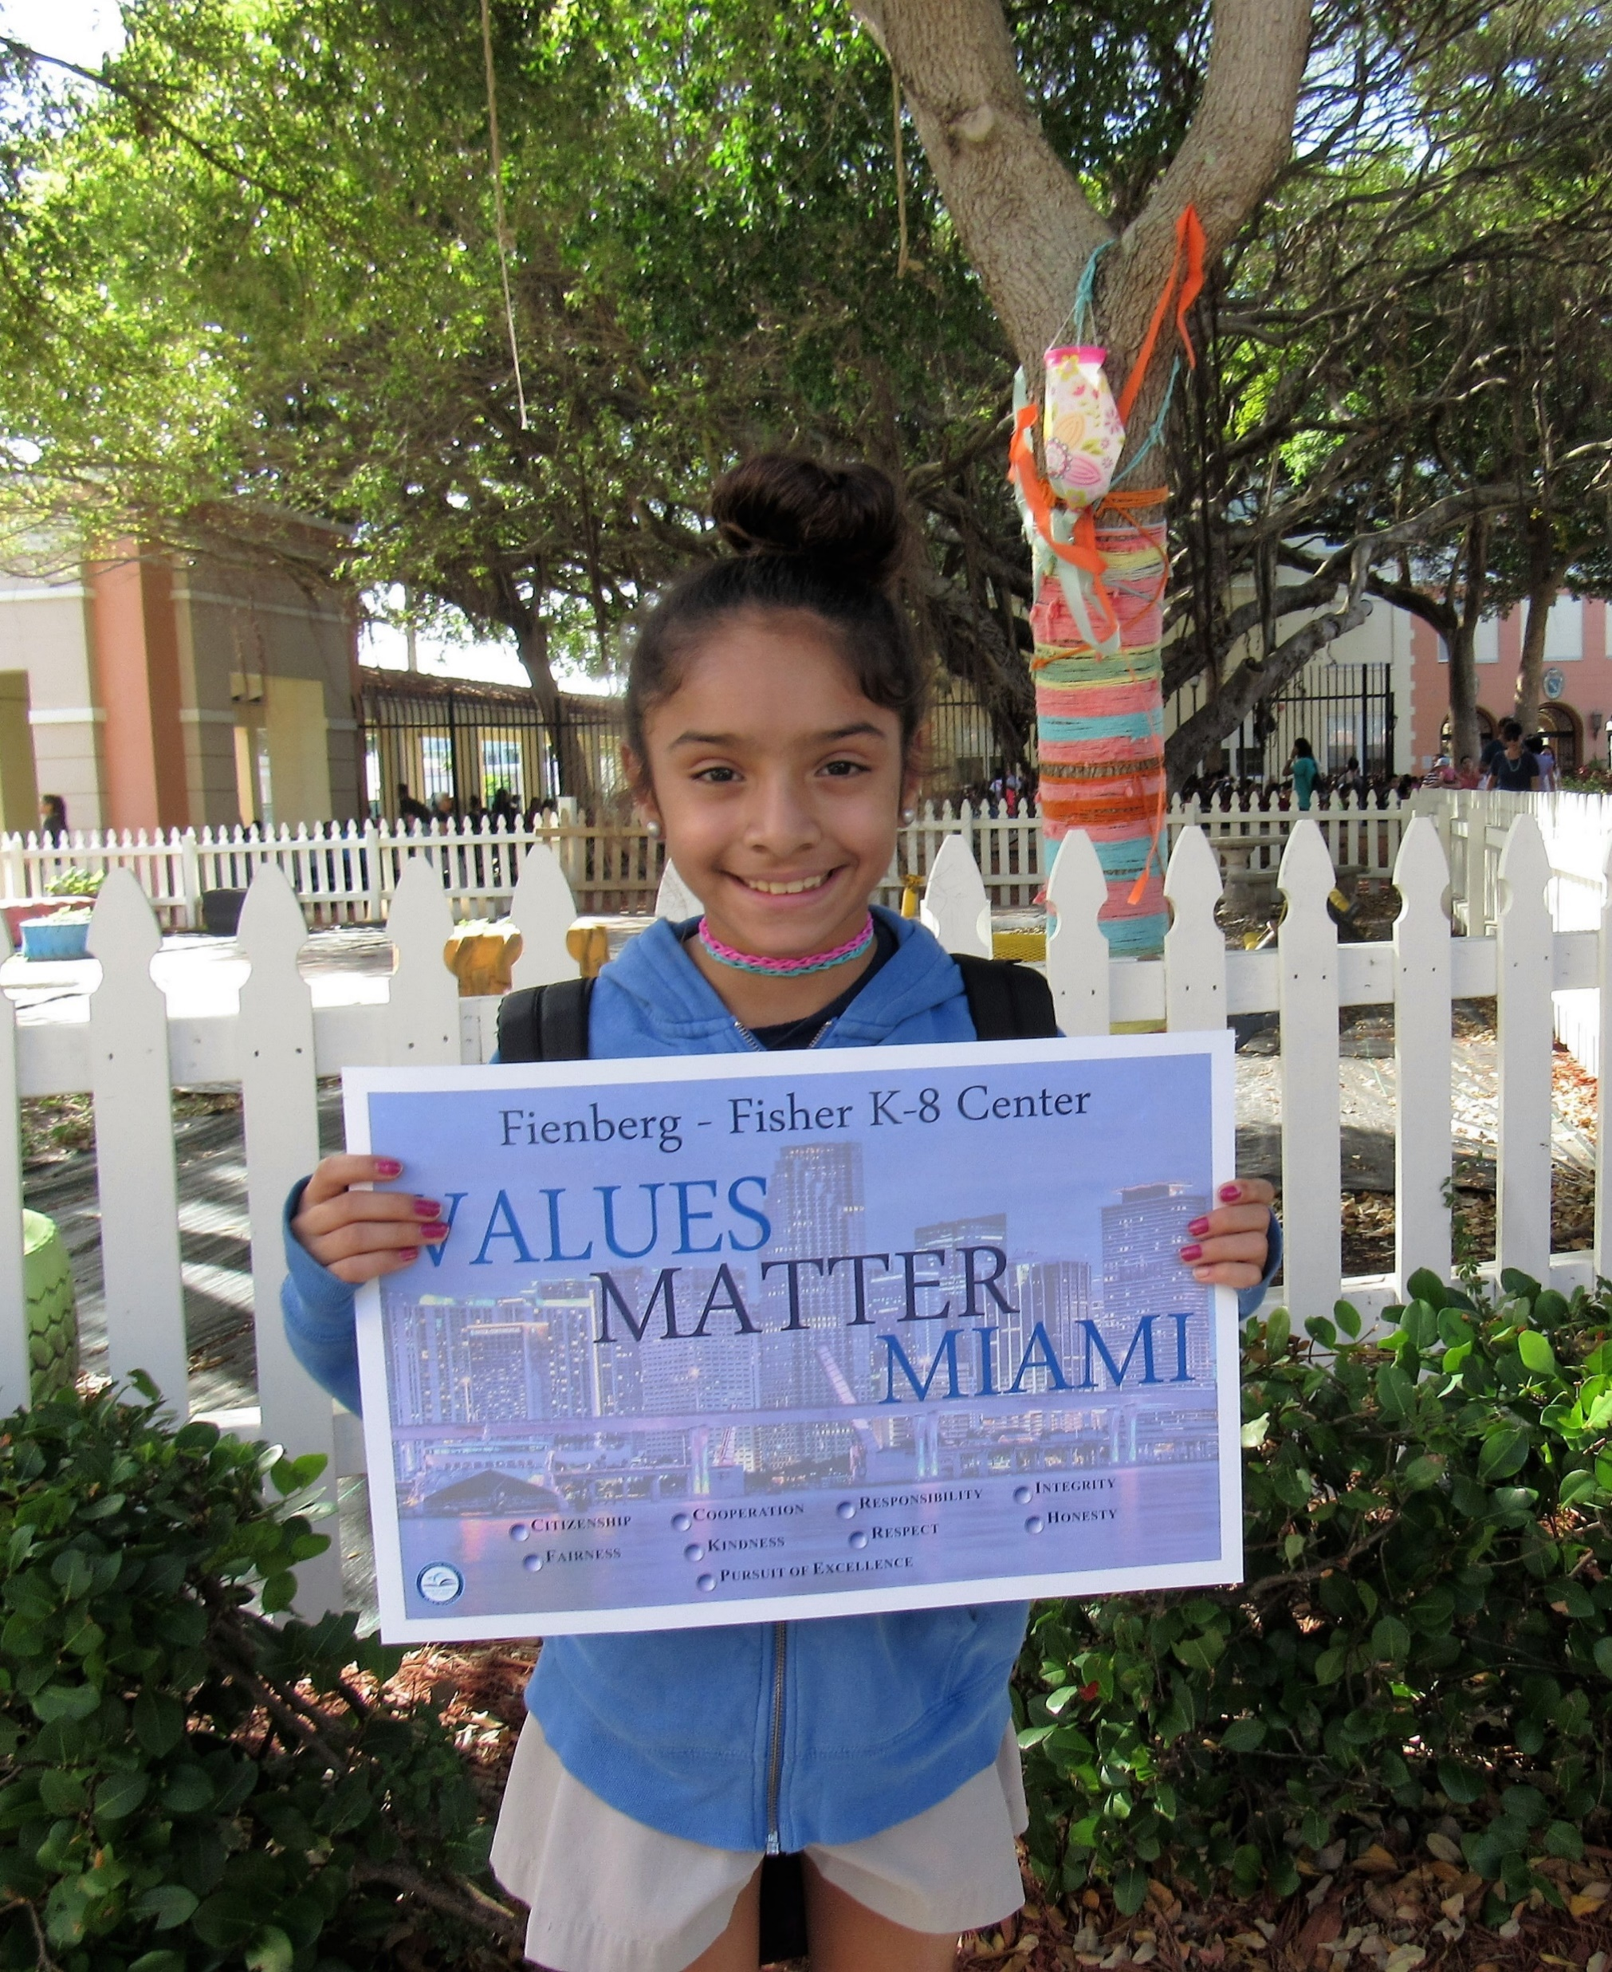
I do the
right thing

Slide 22
Integrity

Slide 23
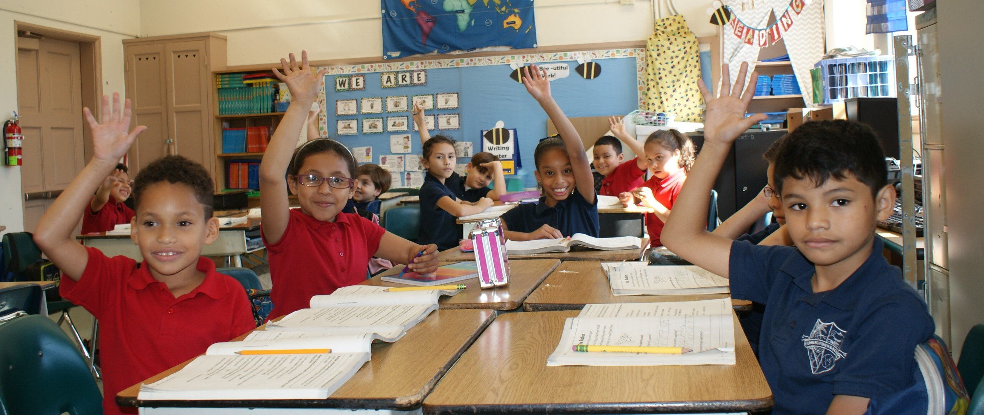
I am polite

Slide 24
Respect

Slide 25
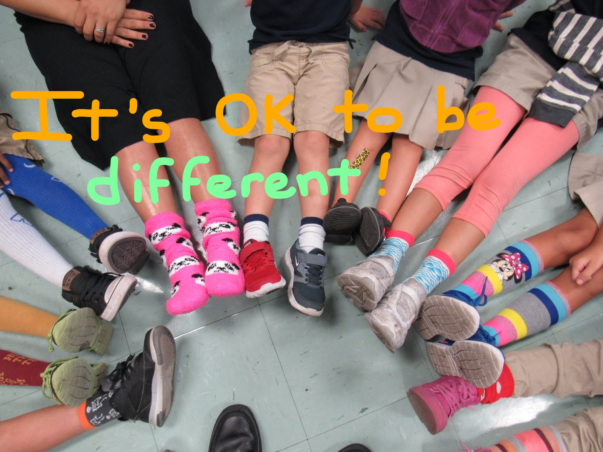
I accept others

Slide 26
Tolerance

